Slide 1
Project dentrite

Slide 2
Problem statement
Create tool to validate if Razer keyboard is working or not working.
Integrate CNN model into automation system.
Notes:
Explain the problems in the company
Explain how you can help automate the process
Explain how you came out with this

Slide 3
Project flow
Build CNN Model
Perform Automated Clicks + Take Snapshot + Prediction
Notes:
Create images to describe
Image(s):
Performing automatic clicks
Camera taking photos of the keyboard
Prediction using CNN
Predicted Report

Slide 4
Problem solution
Train a model to classify images of keyboard
Categorize working keyboards against faulty keyboards

Slide 5
What is image classification?
Process of labelling and organizing images
Labels are assigned based on the images’ features
Generate a faulty (0) or working (1) result
Notes:
Improve the points stated. Give nicer definitions…
Explain what is classification.
Why classification
How classification technique used for image classification?
Technique to solve the problem to predict the categorical variable of a situation.

Slide 6

Technology used
Data Balancing
Convolutional Neural Networks (CNNs)
Transfer Learning
Notes:
Explain data balancing technique
Explain each bullet point!
typically used for image processing
Useful for learning special features such as edges, textures and shapes

Slide 7
Data balancing
‘working’ keyboard images has more images than ‘faulty’ keyboard images
Sklearn.utils.class_weight.Compute_class_weight ()
Estimate class weights for unbalanced datasets
Ensures that less frequent class gets higher weight
Higher weight results in more importance given to that class during training
Notes:
Original Dataset:
y_batch1 = tf.constant([0,1,1]) # Labels for batch 1
y_batch2 = tf.constant([0, 1, 0]) # Labels for batch 2
Firstly, Flatten
[y.numpy().flatten() for _, y in train_ds]
Result: [array([0, 1, 1]), array([0, 1, 0])]
Lastly, Concatenate
labels = np.concatenate([array([0, 1, 1]), array([0, 1, 0])], axis=0)
array([0, 1, 1, 0, 1, 0])

Slide 8
Technology used (Transfer Learning)
GlobalAvgPool2D
Dense(512)
Dropout
Dense

Slide 9
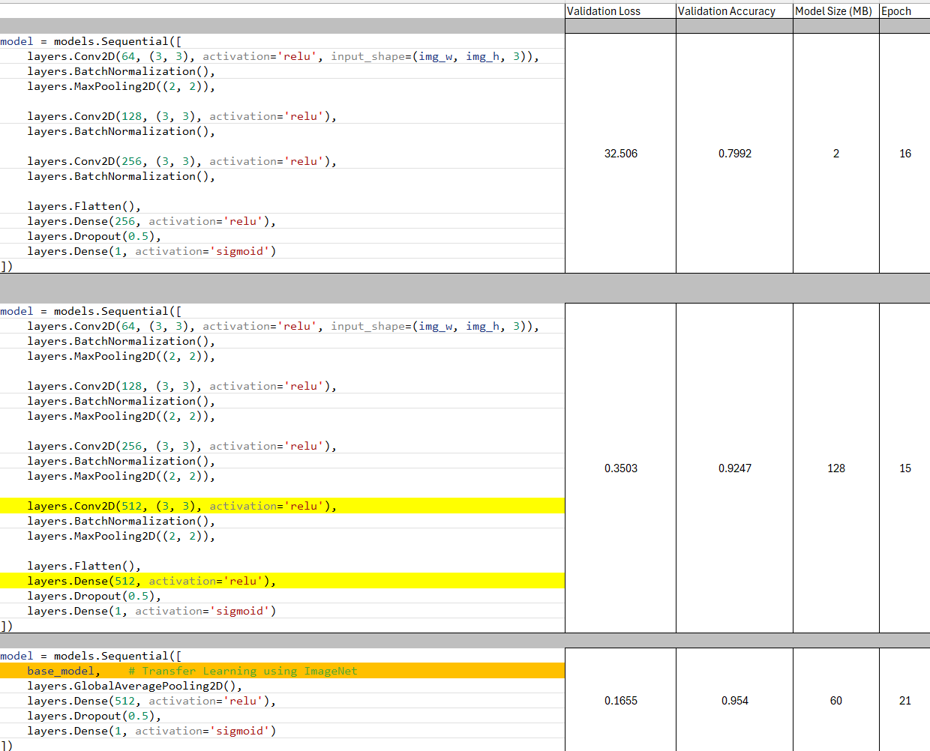

Slide 10
Technology used (w/o xfer learning)
4 Processes used
Conv2D
MaxPooling2D
Flatten
Dense

Slide 11
What is cnn?

Slide 12
Steps involving cnn

Slide 13
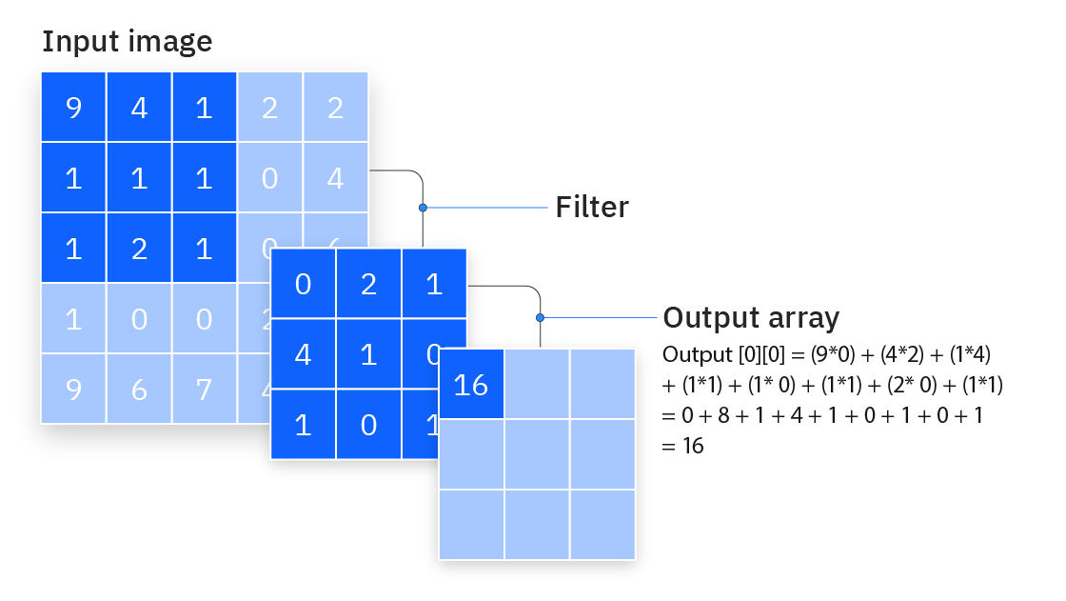
Cnn model architecture
Conv2D
Core building block of CNN
Extracts special features of images (textures, edges, shapes)
Filter moves across image and detect patterns
Generates a Feature Map
Conv2D
MaxPooling2D
Flatten
Dense
Notes:
https://www.ibm.com/content/dam/connectedassets-adobe-cms/worldwide-content/creative-assets/s-migr/ul/g/ed/92/iclh-diagram-convolutional-neural-networks.png

Slide 14
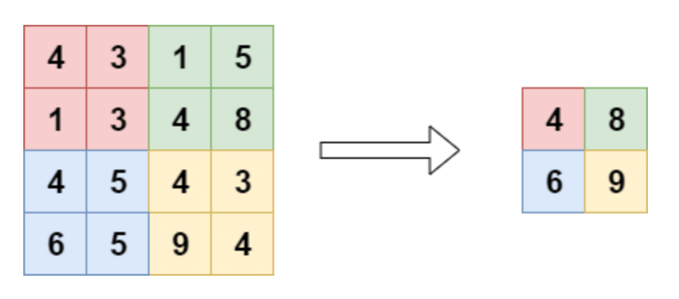
Cnn model architecture
MaxPooling2D
Down samples feature map while retaining important information
Applies max() of each region in Feature Map
E.g., if feature map is 4x4, it will be reduced to 2x2
Conv2D
MaxPooling2D
Flatten
Dense
Notes:
https://www.researchgate.net/publication/344331692/figure/fig11/AS:965939822620684@1607309408773/Pooling-layer-The-pooling-layer-performs-a-downsampling-operation-along-the-spatial.ppm

Slide 15
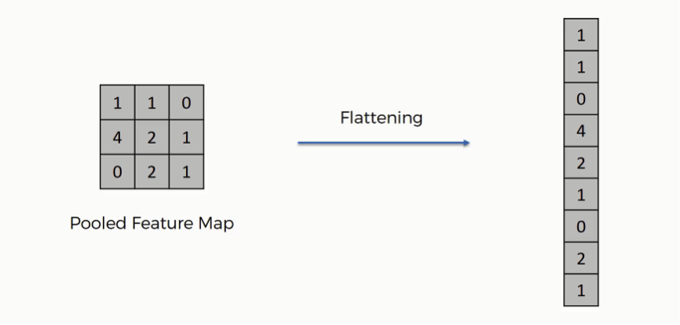
Cnn model architecture
Flatten
Takes output from Convolutional and Pooling operations and flattened into 1D vector
Conv2D
MaxPooling2D
Flatten
Dense
Notes:
https://sds-platform-private.s3-us-east-2.amazonaws.com/uploads/73_blog_image_1.png

Slide 16
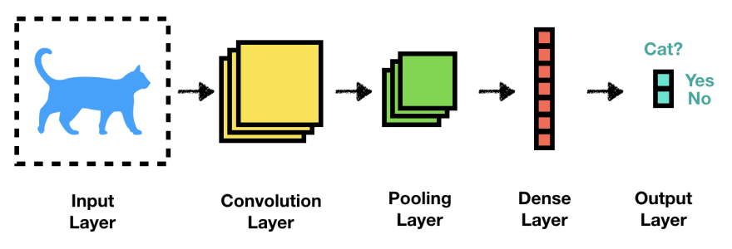
Cnn model architecture
Dense
Takes the 1D vector and perform predictions
Conv2D
MaxPooling2D
Flatten
Dense
Notes:
https://media.licdn.com/dms/image/v2/C4E12AQHa0As6OhBIFQ/article-cover_image-shrink_600_2000/article-cover_image-shrink_600_2000/0/1567401067125?e=2147483647&v=beta&t=mgyh8O5m9cQ9a6VKrATsKDSb5scH410RWZFDjATaOLM
Add own image!!!
Working OR Faulty result at the end.

Slide 17



Project flow
Training
Conv2D
MaxPooling2D
Flatten
Dense
Image
Model

Slide 18


Project flow
Faulty
Result
Image
Model
Working
Notes:
Use keyboard image as input

Slide 19
demo

Slide 20
end

